Slide 1
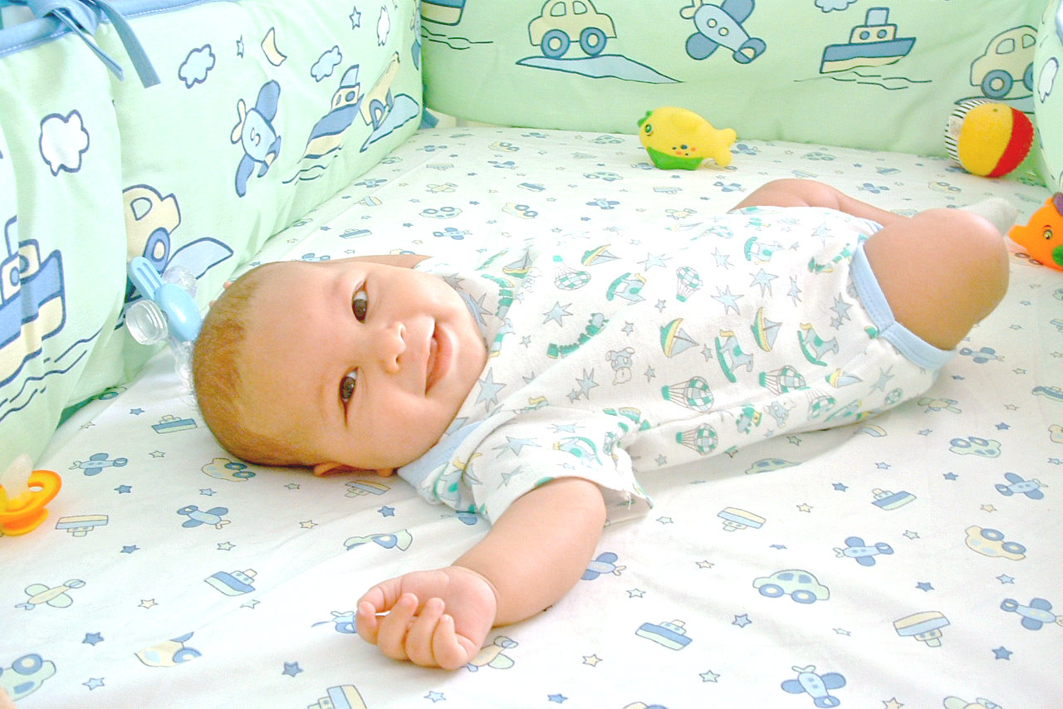
___________________________________________
_______________________________________________________________________________________________________________________________________________________________________________
_________________________________________________________________________________________________________________________________________________________________________________________
_____________________________________________________________________________________________________________________________________________________________________________________________________________________________________________________________________________________________________________________________________________________
____________________________________________________________________________________________________________________________________________________________________________________
_______________________________________________________________________________________________________________________________________________________________________________
_______________________________________________________________________________________________________________________________________________________________________________
Alexander König 2025, mit KI-Unterstützung
Abb.: Carin Araujo 2004, public domain, https://commons.wikimedia.org/wiki/File:Baby.jpg (Zugriff: 07.10.202%)

