Slide 1
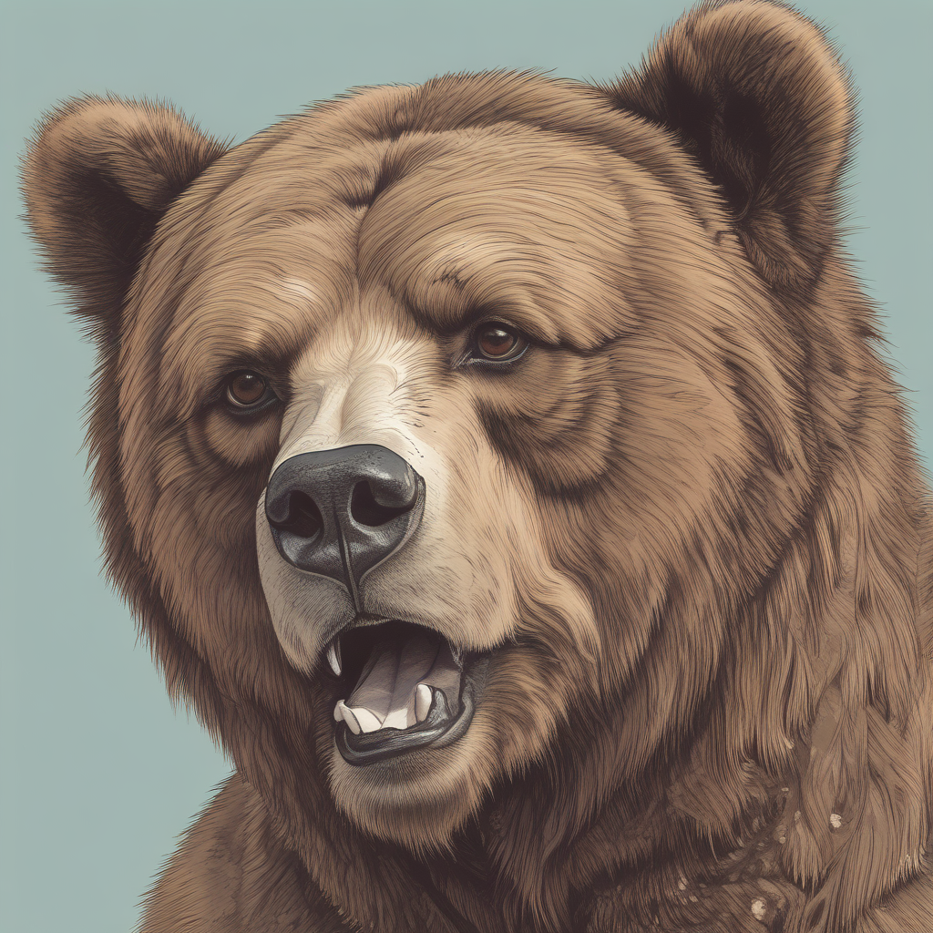
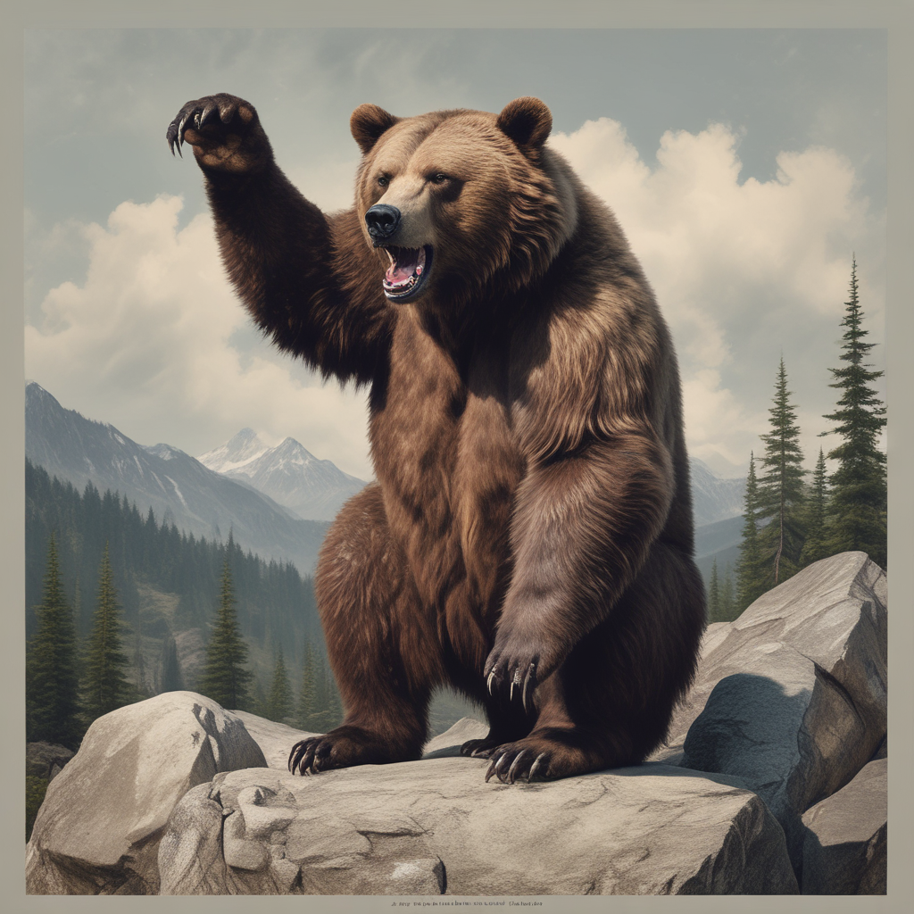
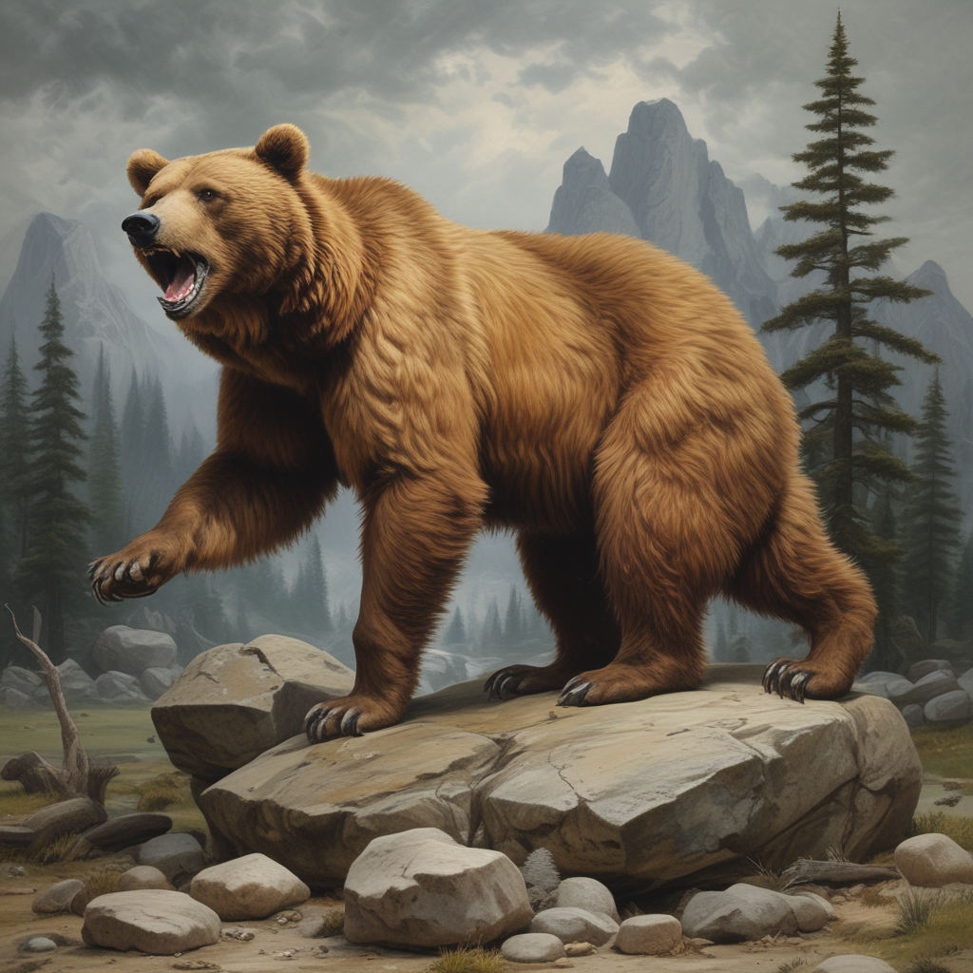
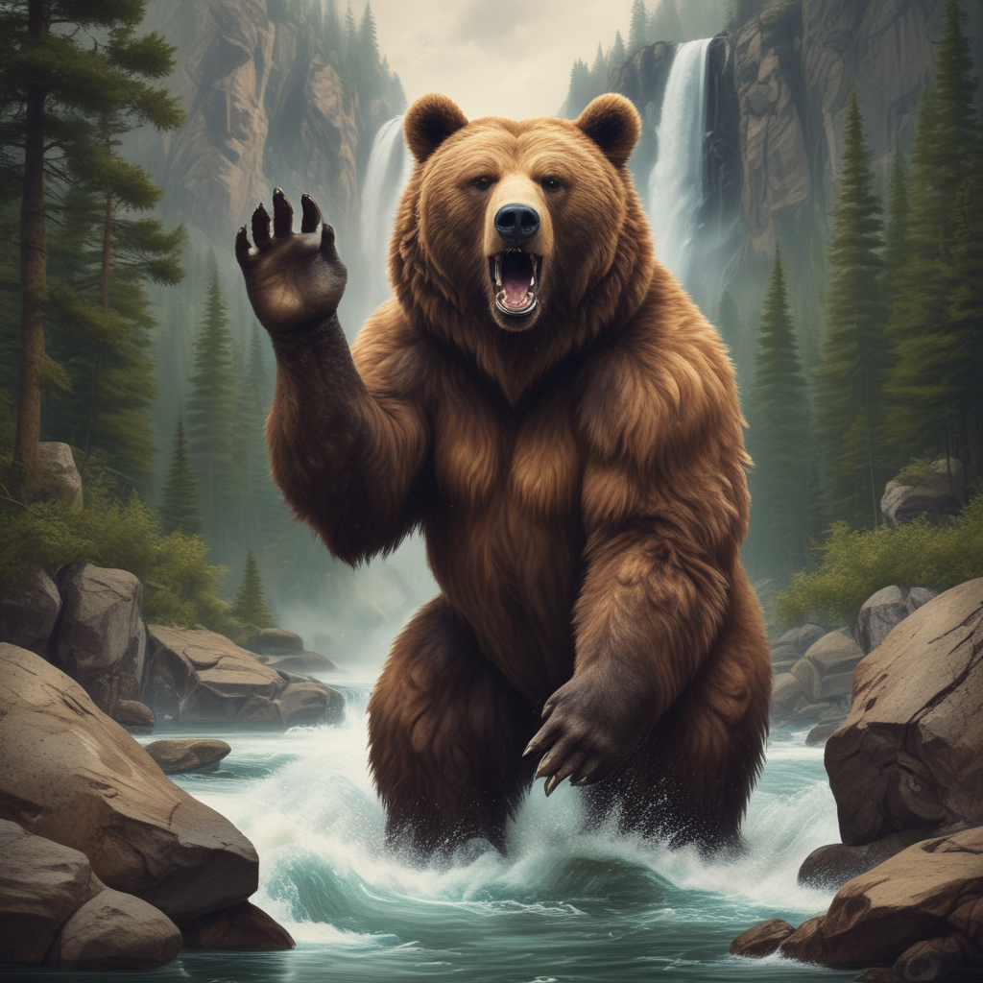
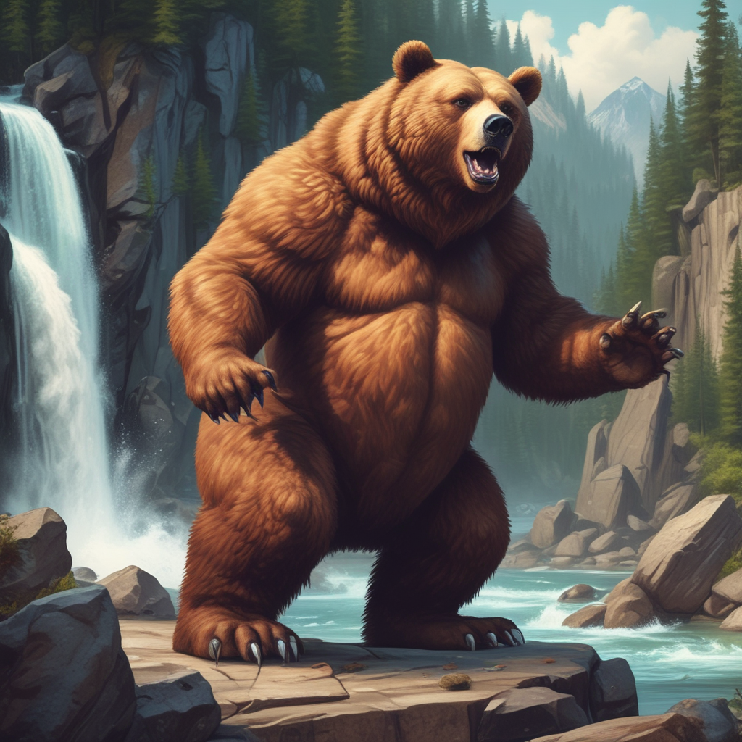
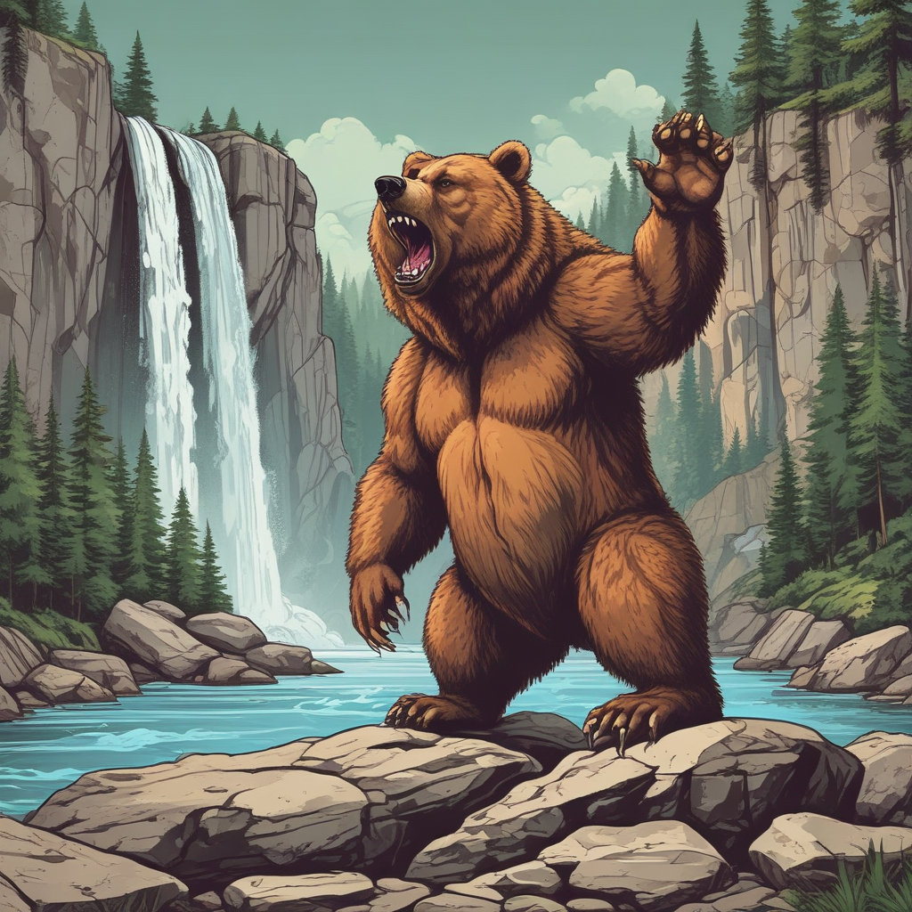
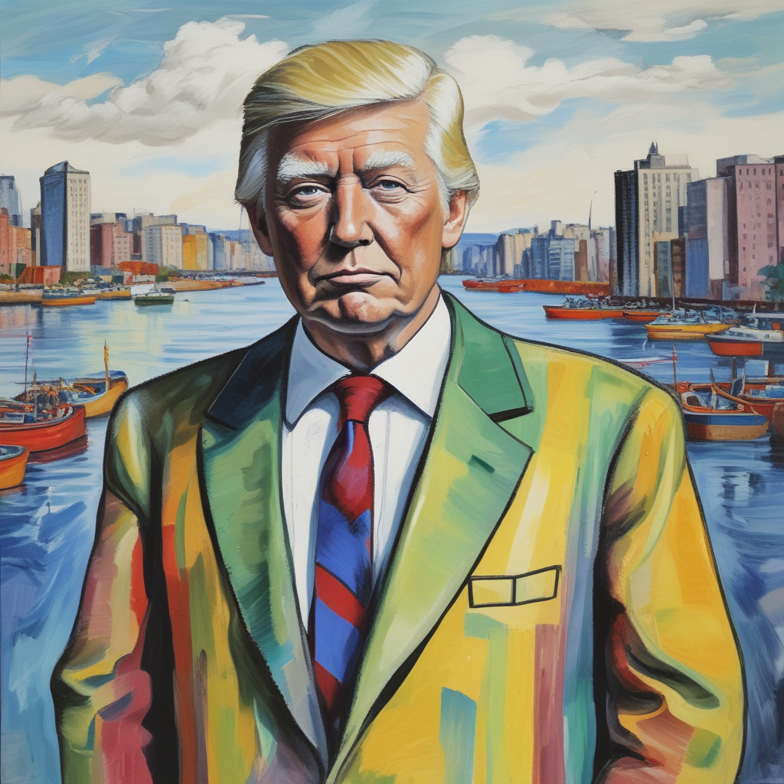
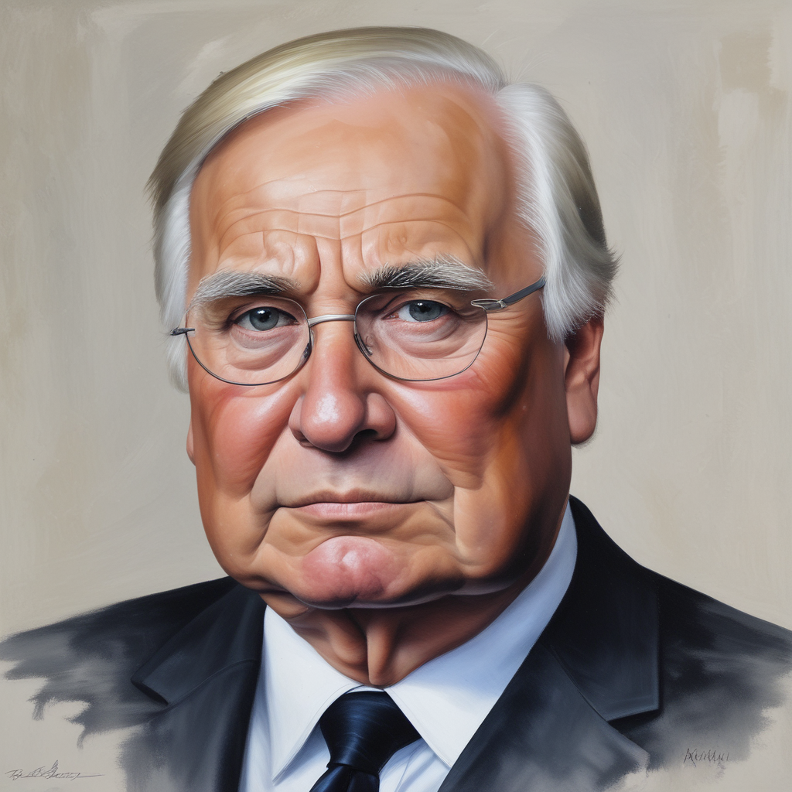
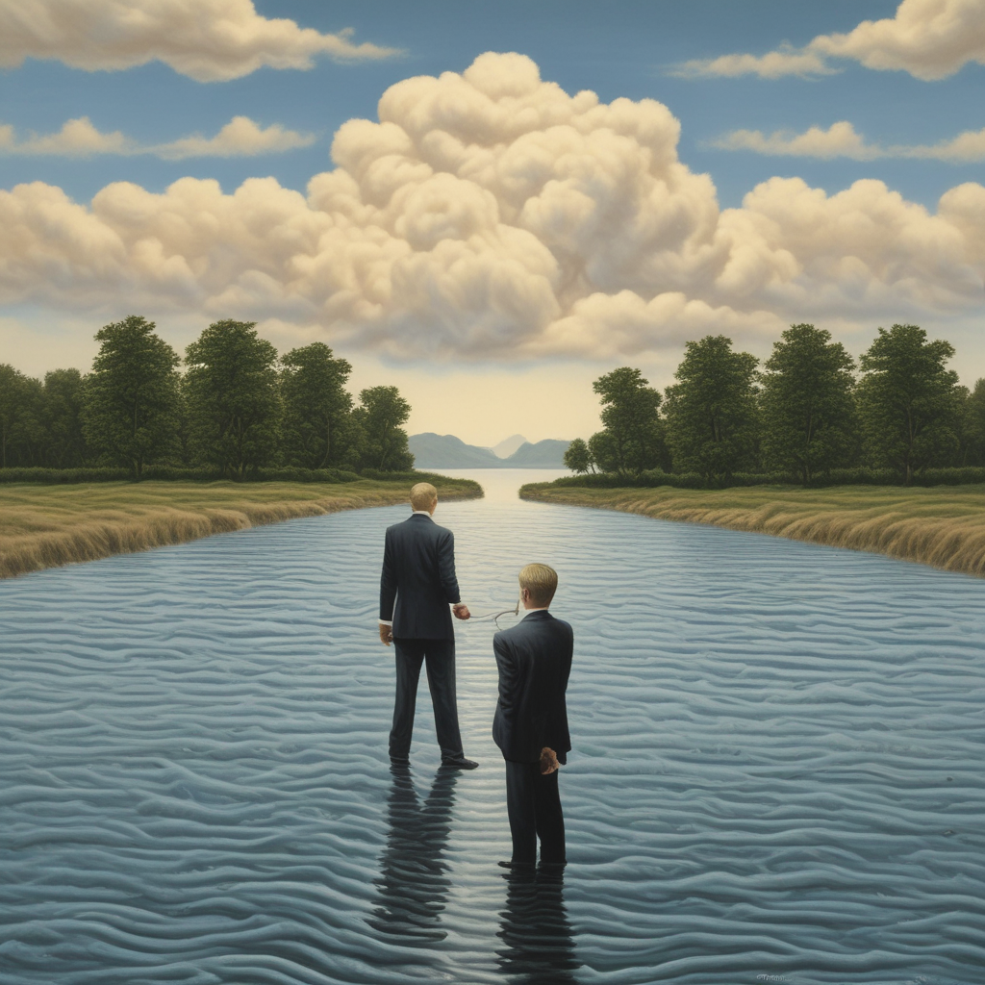
a large bear with its paw raised, standing on a stone, angry looking
bear
a large bear with its paw raised, standing on a stone, looking angry, detailed fur
a large bear with its paw raised, standing on a stone, looking angry, detailed fur, background: river, forest, waterfall
a large bear with its paw raised, standing on a stone, looking angry, detailed fur, background: river, forest, waterfall, cartoon
a large bear with is paw raised, standing on a stone, looking angry, detailed fur, background: river, forest, waterfall, cartoon, pop art
Imitation
Blending
Donald Trump, river, style:Picasso
Oil painting portrait of [Helmut Kohl: Donald Trump: 0.5]
Donald Trump, river, style:Magritte

