Slide 1
Dual VET in Germany

Slide 2
Contents
Dual VET in Germany
  Basics and Framework Conditions
  Motivation, Interests and Process
  The Success Model
Notes:
Examination boards with equal representation, jointly agreed training standards, joint management of the system at all levels
Around 70 % in the company
Vocational training standards, certificate issued by the chamber
In and from the companies, state teachers at the vocational schools
Data reports, vocational training report, training standards (BIBB)

Slide 3
Dual VET:
Basics and Framework Conditions

Slide 4

Basics
Dual VET in the German Education System at a Glance
Labour market
VET
Fulltime school based
Dual VET
University education
School education

Slide 5

Basics
Parties involved: Trainees
  1.22 Mio. trainees p. a.
  in 324 recognised professions
That implies:
  5 % of all employees are trainees
Notes:
Supplementary information:
Overall, approximately 51 % of the population have started a dual vocational training programme in their lifetime
According to the IAB Forum (2023), 85 % of graduates in 2020 were in employment subject to social insurance contributions.
The positive effect:
Youth unemployment in Germany is only around 5,7 % (2025)

Slide 6

Basics
Parties involved: Employers
  Every year, around 18,7 % of all companies employing staff subject to social insurance contribution engage
  in training (ca. 396,800 of 2.1 Mio.)
  Around 475,950 new trainees p. a.
  79 % of them will be directly taken over after the training
Notes:
Supplementary information:
Trainees are on average 19.9 years old (2024)
The average investment per trainee per year is 26,210 euros (2022/2023)
69 % of this (approx. 18,124 euros) is amortised (productive contribution of the trainees)
This means:
international competitive advantage for German SMEs
future personnel trained according to own needs
low investment on the labour market

Slide 7
Basics
Businesses, Social partners and the Government ensure the Framework Conditions of Dual VET
  Chambers
  Social partners (Unions and Employers‘ associations)
  Government
Chambers and Social Partners: Define and check training contents in the companies
Government: Shapes the legal framework and provides the resources for
school-based training
Notes:
Supplementary information:
The three stakeholders ensure the framework conditions for vocational education and training through a differentiated distribution of roles
Ownership lies with all three players; they all bear it at the same time and assume responsibility
They guarantee the system's constant capacity for innovation
They ensure quality standards

Slide 8
Basics
Stakeholders: Chambers - the Competent Bodies
  Check and register training companies
  Monitor and check in-company training
  Train in-company training personnel
  Organise examinations
  Organise events and engage in consultancy
Notes:
The impetus for the development and updating of training standards comes from companies and chambers. They know best which skills are needed.
Other tasks:
Supporting companies in their search for trainees, registering training contracts
Mediation in the event of disagreements between trainees and companies
The economy invests €9.7 billion in vocational training every year (2024)

Slide 9
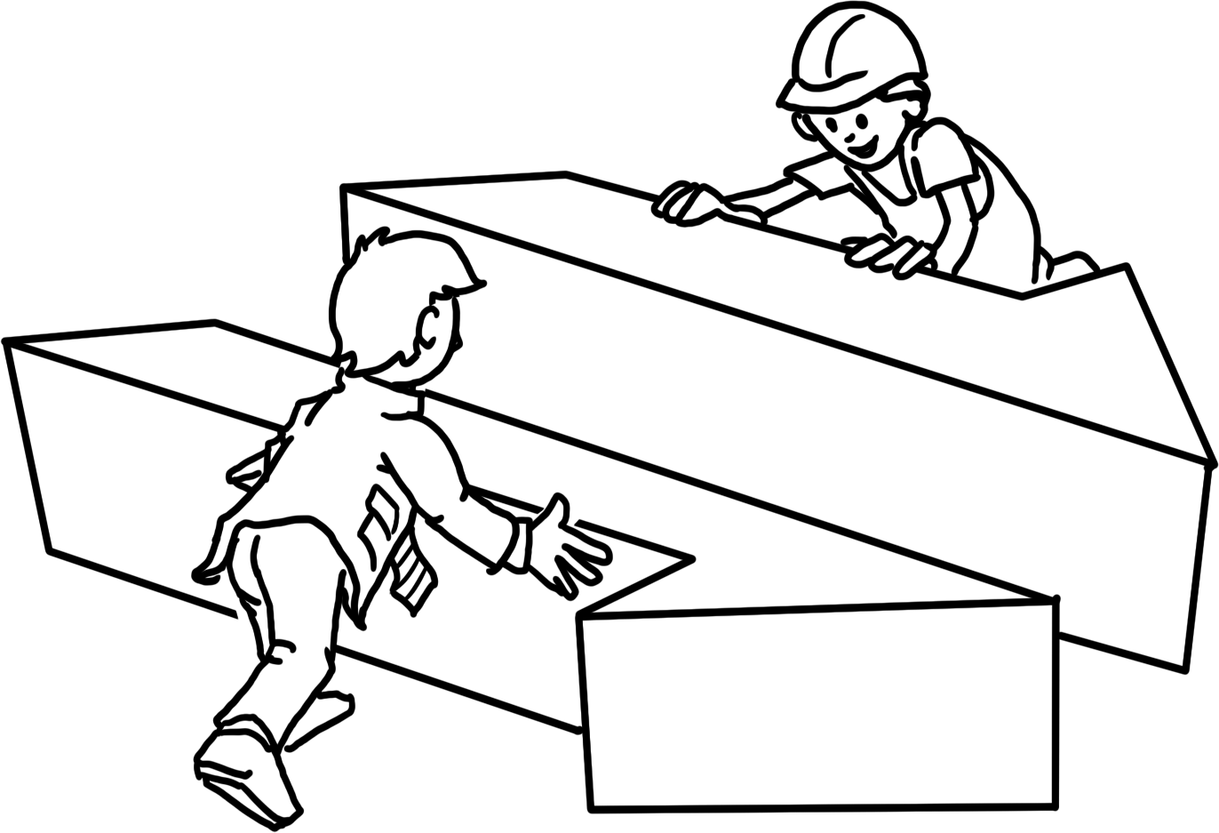
Basics
Stakeholders: Social Partners
Unions and Employers‘ associations negotiate the standards (training regulations) for in-company training with each other and with the Government
  Training contents
  Trainees‘ remuneration
  Monitoring of in-company training
  Participation in examination boards
Notes:
Supplementary information:
The process of coordinating and adopting new training regulations is managed by the Federal Institute for Vocational Education and Training.
Economic and social partners are involved in the entire process.

Slide 10
Basics
Stakeholders: The Government – Providing the Framework
  Negotiates training regulations with the social partners (in-company training)
  Defines training in vocational schools: framework curriculum
  Finances and organises the public vocational school system
  Conducts VET research (BIBB)
  Supports people searching for an apprenticeship (e. g. teenagers, unemployed or disadvantaged people)
Notes:
Detailed information:
State funding for the dual system totals around € 4.4 billion, including over € 3.4 billion for 1,550 vocational schools and around € 0.9 billion for control, monitoring and support measures (2023)
State passes the Vocational Training Act

Slide 11
Basics
The Framework: Standards
  Define the implementation of dual VET in companies and vocational schools
  Secure quality control and the promotion of dual VET
  Are valid and compulsory nationwide
Notes:
If necessary, summarise the previous slides again
Three main stakeholders agree on the basic standards for dual vocational training on an equal footing.
These standards are based on the specific requirements of the world of work.

Slide 12
Basics
The Framework: Standards – Development
  1. Employers identify new tasks and qualifications in the companies
  2. Social partners and the Government negotiate and pass new training standards, moderated by the BIBB
  3. The Government adjusts framework curricula to the newly-defined training standards
The adopted standards are fixed in training regulations (in-company training) and framework curricula (school-based training).
Notes:
Supplementary information:
The duration of the further development and implementation of standards is max. 1 year
Standards are dynamically adapted to the requirements of the world of work at both learning venues
BIBB continuously researches changes in work and training; the findings are incorporated into the process

Slide 13
Basics
The Framework: Standards – Training Regulations
The common goal follows the 'occupation principle‘
Training standards for in-company training are fixed in training regulations:
  Occupational title
  Training profile
  Contents
  Timeframe and temporal structure (training plan)
  Examination requirements
Notes:
Job profile
Which competences must be taught?
Contents
Which specific skills and tasks must be mastered?
Examination knowledge
What knowledge optimally prepares trainees for their final examination?

Slide 14
Basics
The Framework: Standards – Framework Curriculum
Training in the vocational school provides the necessary professional theoretical expertise and expands general knowledge.
These standards are defined in the framework curriculum:
  Learning objective
  Contents
  Learning field
Notes:
The contents of the framework curriculum are defined by ‘learning fields’.
If necessary, explain the topic of ‘learning fields’ at this point.

Slide 15
Basics
The legal framework
Freedom of Occupation according to Article 12 of the Basic Law (Constitution)
Business Laws
School Laws
Vocational Training Act
Law for the protection of young people
at work
Crafts and Trades Regulation Code
Law on Collective Bargaining
Law on the Chambers of Commerce
Works Constitution Act
Compulsory schooling
Regional school laws
Notes:
Explain the dynamics of the vocational training system using BBiG amendments, most recently:
2020: principle of equivalence of vocational and academic education codified
2024: Vocational Training Validation and Digitalisation Act (BVaDiG)

Slide 16
Dual VET:
Motivation, Interests and Process

Slide 17

Access
Motivation and Measures – the Government
Motivation: Germany needs skilled workers to secure economic growth
and development.
Insight: We need to strengthen and steer our dual VET system.
Measures:
  Provide and update the legal framework
  Mandate further stakeholders
  Analyse and develop the system (e. g. through BIBB)
Notes:
Further motivation:
Vocational training secures the social status of young people as citizens
The state cannot guarantee vocational training alone: costs and competences
Further measures:
Ensuring permeability: university access for trainees with a degree
Opening up dual vocational training regardless of previous qualifications

Slide 18

Access
Motivation and Access – Young People
Motivation: „I want to become a … !“
Access:
  Find potential employers
  and screen openings
  Write application
  Undergo selection process
  Choose training company
  Sign training contract
Notes:
Young people have many different expectations and goals when it comes to an apprenticeship:
learn something practical
earn their own money (self-employment)
realise a dream
social prestige
fulfilment of duties

Slide 19
Access
Motivation and Access – Companies
Motivation: „I need to be secure about filling all job openings.“
Access:
  Register as a training company
  Offer traineeships
  Analyse applications
  Choose trainees
  Sign training contracts
Notes:
There are a few other reasons here too:
We are looking for loyal employees
We know best which qualifications are needed in our company
We want to act in a socially responsible manner
We seek the input and innovative potential of young people
We save on familiarisation and retraining costs

Slide 20

Process
The Training Contract
The professional training starts with signing the training contract between employer and trainee.
The training contract regulates:
  Duration
  Contents
  Probation period
  Temporal and factual structure
  Remuneration
  Rights and obligations of both parties
Notes:
The training contract also regulates
holiday entitlement
any requirements for termination of the training contract
The training contract is similar to an employment contract. It is the basis for learning in the company during training.
The training contract is registered by the chambers.

Slide 21

Process
Dual Learning at two venues
70 % Training in the company
30 % Lessons in vocational school
Structured training under real work conditions
Trainees participate in actual business activities
Trainees receive a remuneration
Lessons in class
Occupation related (2/3) and
General (1/3) subjects
Dual VET lasts from two to three and a half years.
Notes:
Legal basis:
... for in-company training: Training contract
... for the vocational school: Compulsory schooling
Time allocation:
for example:
Monday to Wednesday: in the company
Thursday and Friday: at the vocational school
Alternatively: block teaching
Additional information:
In-company training and vocational school lessons follow the training standards

Slide 22
Process
Examination
The Final Exam
  Organised by the chamber
  Theoretical and practical part
  Examination board with
    Employers‘ representatives
    Employees‘ representatives (Trade Unions)
    Vocational school teachers (representing the Government)
Notes:
Important:
No involvement of the respective teaching and training staff!

Slide 23
Process
The Final Exam
Vocational Certificate
  Issued by the chamber
  Officially recognised
The successful examination ends the training. The professional career begins.

Slide 24
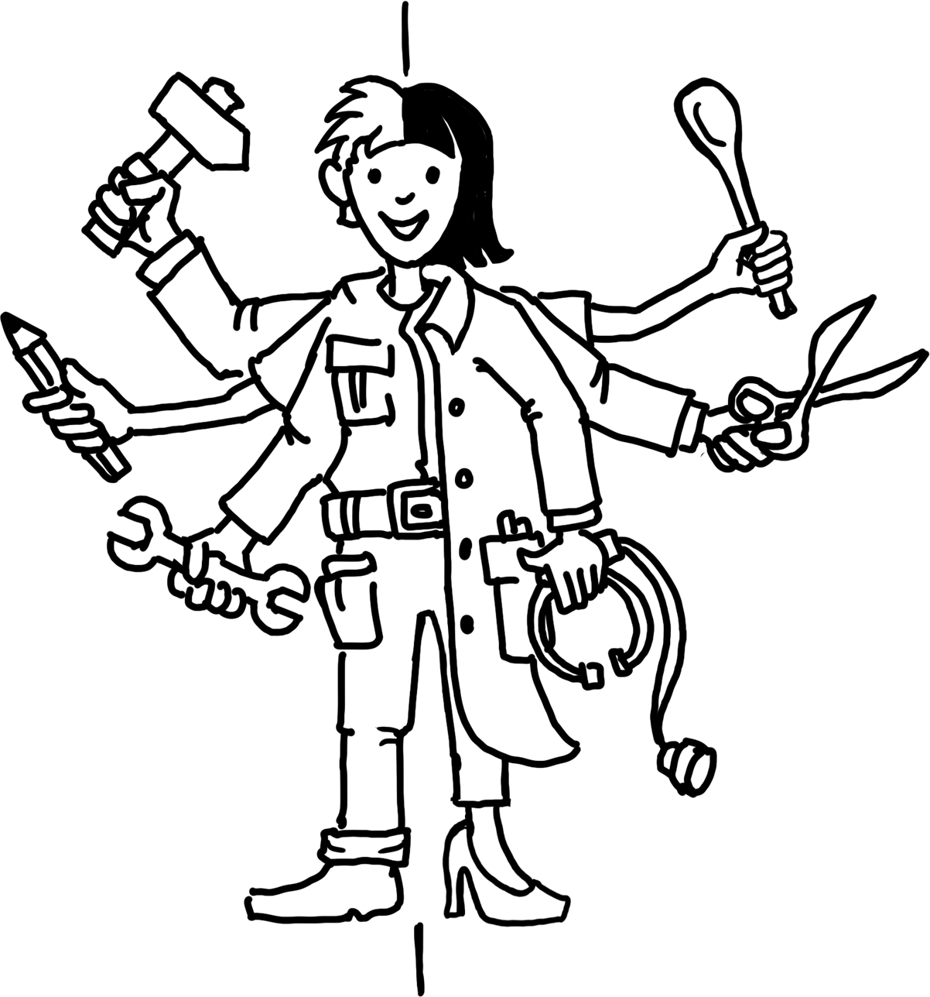
Process
Beginning of the Vocational Career: Opportunities
On the Labour Market
  Employment contract with the initial training company
  Employment contract with another company
  Employment in another (neighbouring) vocational field
Continuation of Training
  Further training measures (building on existing qualification, if applicable)
  University studies („tertiary education“)
Notes:
As a reminder:
According to the IAB Forum, 85 % of graduates in 2020 were in employment subject to social insurance contributions
Around 79 % of all trainees are taken on by the company that trained them.

Slide 25
Dual VET:
The Success Model

Slide 26
How Does Dual VET Work?
Summary
Process
  Training parallel in the company (70 %) and vocational school (30 %): „Dual“
  Training with defined contents and duration (Training contract)
  Training in actual business operations
  Final exam before an examination board

Slide 27
How Does Dual VET Work?
Summary
Framework
  The Government provides the legal framework
  The Government organises the school-based part of training
  Chambers and social partners define contents and range of training
  Chambers as competent bodies monitor company-based training
Notes:
Reminder:
Chambers are the representatives of the economy, trade unions/employee representatives and associations/employer representatives are the social partners.
They reach a consensus.
Conclusion I:
Dual vocational training is essentially shaped by those who are directly affected and who know the needs of the labour market best.
Conclusion II:
All decisions on vocational training are made by consensus.
Conclusion III:
The standards apply nationwide. They are regularly updated.

Slide 28
Why is Dual VET in Germany Successful?
Success factors
  Historically grown system
  High acceptance in society
  Win-win-situation for trainees and companies
  Training according to the demand for skilled labour
  Strong institutions (chambers, social partners, SME)
  Active contributions by all stakeholders
  High flexibility and adaptability of the system
Notes:
Demand for skilled labour:
Germany is a developed industrialised nation with a strong SME sector.
Win-win situation:
Apprentices learn on the job and are integrated into the work process. Companies train their own future workforce according to their own needs
Qualified training staff:
Trainers are ‘from the trade’ and have undergone training themselves and also know the company
Supplementary information:
Although the state controls the process as a legislator and sets the framework, it leaves key decisions to the direct stakeholders.

Slide 29
Five Quality Features of Dual VET
Cornerstones
  Cooperation of government, business community and social partners
  Learning within the work process
  Acceptance of national standards
  Qualified VET staff
  Institutionalised research and advice
Notes:
Examination boards with equal representation, jointly agreed training standards, joint management of the system at all levels
Around 70 % in the company
Vocational training standards, certificate issued by the chamber
In and from the companies, state teachers at the vocational schools
Data reports, vocational training report, training standards (BIBB)

Slide 30
Benefits
Benefits for trainees:
Dual VET is the ideal preparation for a professional career:
  Occupation specific competencies and qualification
  Real work conditions (equipment, procedures, work environment)
  Remuneration
Notes:
Further advantages:
Greater identification with the training company
Training as a basis for further measures

Slide 31
Benefits
Benefits for companies:
Dual VET secures qualified personnel:
  Qualified workers, in accordance with company-specific requirements (as opposed to external applicants)
  Increased productivity (fast amortisation)
  Active participation of the business community in developing training standards
  Contribution to Corporate Social Responsibility (CSR)
Notes:
Another advantage:
Recruitment and retraining costs are reduced

Slide 32
Benefits
Benefits for the Government and Society:
Joint benefit, wealth and social peace:
  High economic performance and productivity
  Balance in the labour market (supply/demand)
  Social and economic integration of young people
  Contributions of all stakeholders
Notes:
Another advantage:
Early indicator for developments in the economy and labour market

Slide 33
Challenges
Challenges from Trainees‘ Point of View
  Discrepancy between demanded and supplied training positions (lack of openings)
  Access to Dual VET
  Increasing occupational demands
  Lifelong learning
Notes:
Discrepancy:
2025: approximately 84,000 applicants without a training place
Access:
Lack of informal skills: Discipline, reliability, basic skills (reading, writing, maths)
Requirements:
For example: IT skills, foreign language skills
Lifelong learning:
Especially for older applicants

Slide 34
Challenges
Challenges from Businesses‘ Point of View
  Discrepancy between demanded and supplied training positions (lack of applicants)
  Unprepared trainees
  Inclusion of people with special needs
  Inclusion of migrants
Notes:
Discrepancy:
Unfilled training places 2010: 19,800 / 2025: 54,400 – almost tripled
‘Maturity for training’:
Lack of social skills, basic knowledge
Inclusion:
High extra personnel and time expenditure, special qualifications of the training staff

Slide 35
Challenges
Challenges from the Point of View of the Government and Society
  Demographic change
  Foreseeable lack of skilled labour
  Trend of academisation
  Regional discrepancies
  Inclusion
Notes:
Demographic change
Fewer young people able to go into training, labour market needs can no longer be met
Trend towards academisation
Training tends to be out, university is in
Regional differences:
Supply and demand for training places
Inclusion:
as a social task

Slide 36
Further Sources
Facts and figures
BIBB Data Report (link)
VET Report BMBFSFJ (link)
Federal Statistical Office (link)
BMFTR Data Portal (link)
BIBB Report 2/2025 (link)
IAB-Forum (link)
Dual VET standards
BIBB Brochure: Vocational Training Regulations and
the Process Behind Them (link)
Example: training regulation and
framework curriculum (link)
Legal documents
Vocational Training Act (link)
Works Constitution Act (link)
Web resources
GOVET (link)
BMBFSFJ (link)
BMFTR (link)
BIBB (link)
Contact for further questions
govet@bibb.de

Slide 37
GOVET at BIBB

